Slide 1
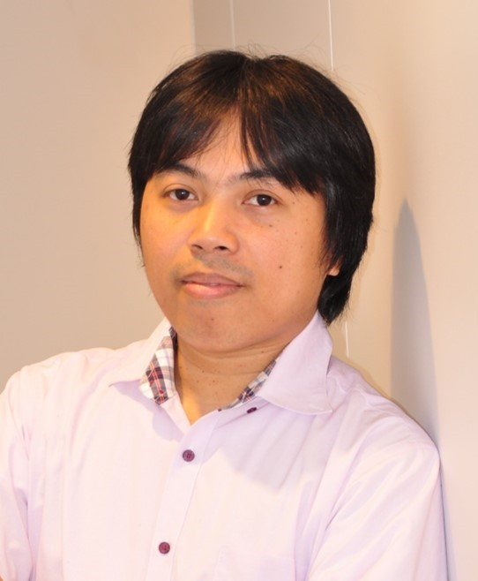

□第44回 MaDIS研究交流会
（OPEN SEMINAR SERIES）
Approaches and Challenges in Finding Promising Novel Solid Electrolytes for All-Solid-State Battery Application by Materials Simulations and Machine Learning Techniques
2019 6.27 (木)
17:00-18:00
（Changed)
M-cube棟 2階中会議室
Randy Jalem
Position
エネルギー・環境材料研究拠点,
界面計算科学グループ
MaDIS、CMI^2, 蓄電池材料グループ
Material search via combined high-throughput materials simulations and machine learning techniques has now become widespread in many technological fields, aiding experimentalists by narrowing down large lists of possible candidate materials in terms of target properties. In this talk, recent efforts of our group related to the development of efficient computational methodologies for finding novel fast ionic conductors for potential use in battery applications will be presented. To address the computationally prohibitive cost of calculating transition-state-related properties (e.g., ionic conductivity, ion migration energy barrier) such as by DFT method, a computational workflow was developed that embeds the DFT method which calculates the computation-intensive property into a Bayesian optimization framework. We demonstrate this approach by searching for oxide-based compounds with low ion migration energy barrier (Sci. Rep.
2018, 8, 5845). Another topic is about development of general descriptors for crystalline solids for use in large-scale machine-model-driven material screening, based from established chemical/elemental data and real feature values from Voronoi tessellation information of crystal structures (STAM 2018, 19, 231). Present challenges that still need to be solved for an effective and efficient solid electrolyte search will also be highlighted in the talk.
◎世話人︓出村 雅彦
◎連絡先：MaDIS運営統括室<madis@ml.nims.go.jp>

